Slide 1
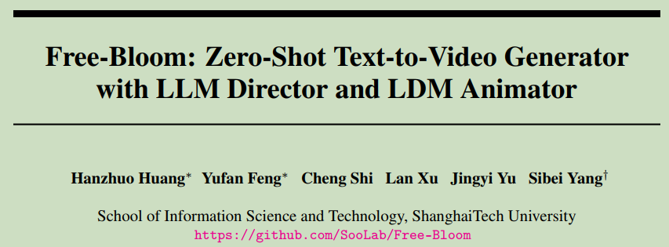
5. Free-Bloom: Zero-Shot Text-to-Video Generator with LLM Director and LDM Animator , NIPS2024, ShanghaiTech University

Slide 2
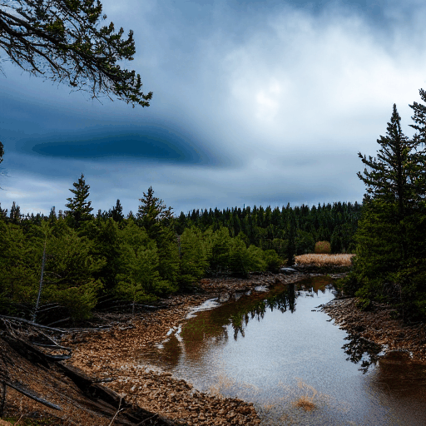
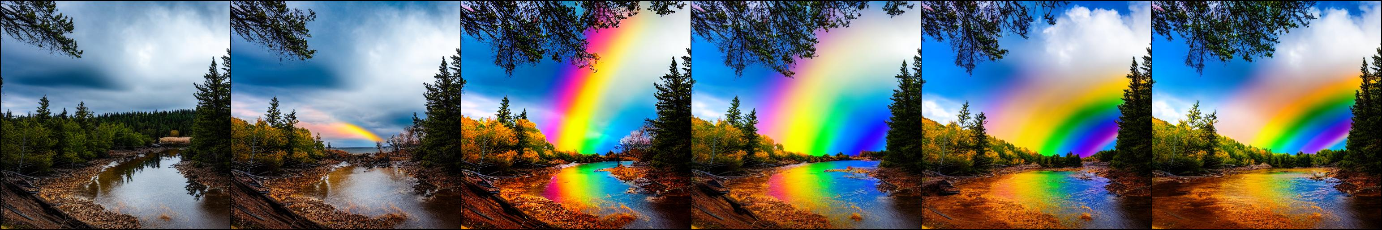

A rainbow is forming
Seed=324423 (paper demo)

Slide 3

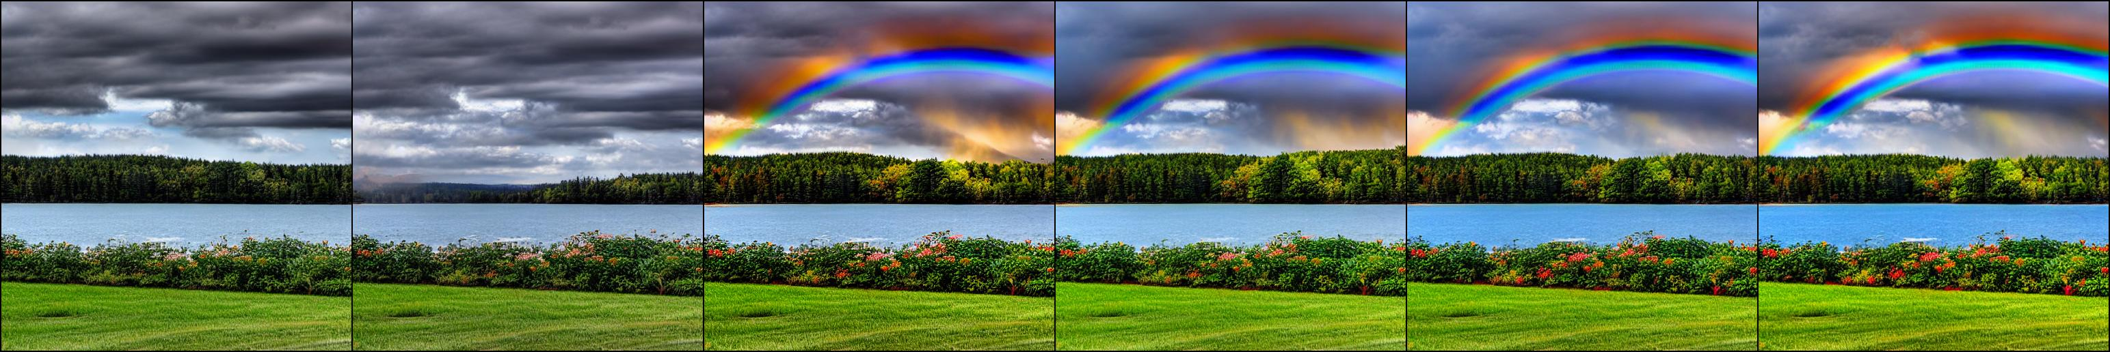

A rainbow is forming
Seed=1234

Slide 4
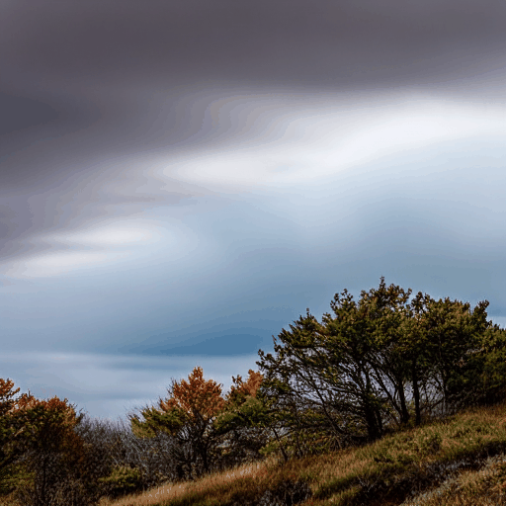
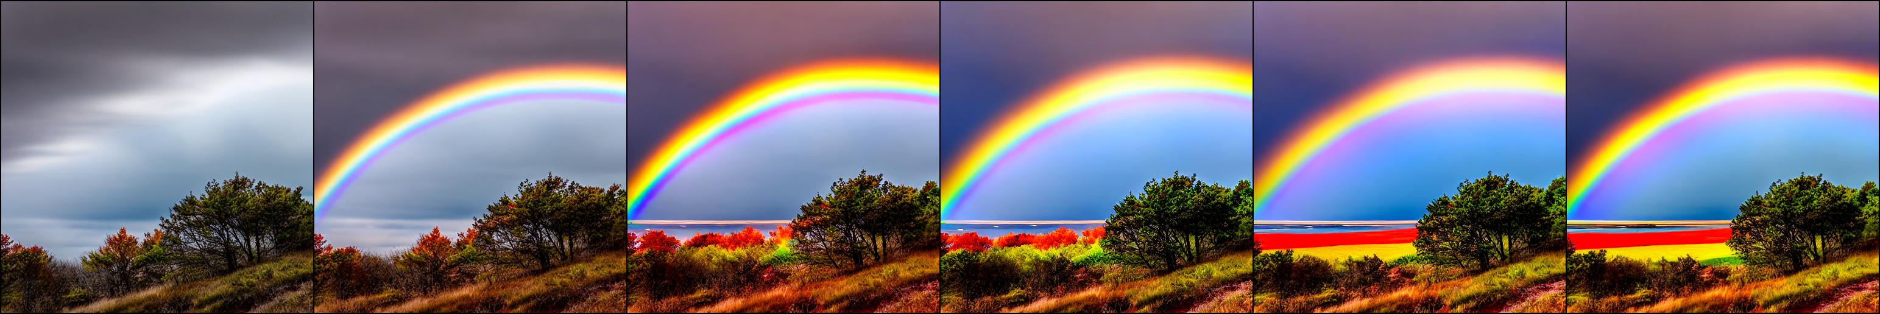
A rainbow is forming
Seed=9999

Slide 5

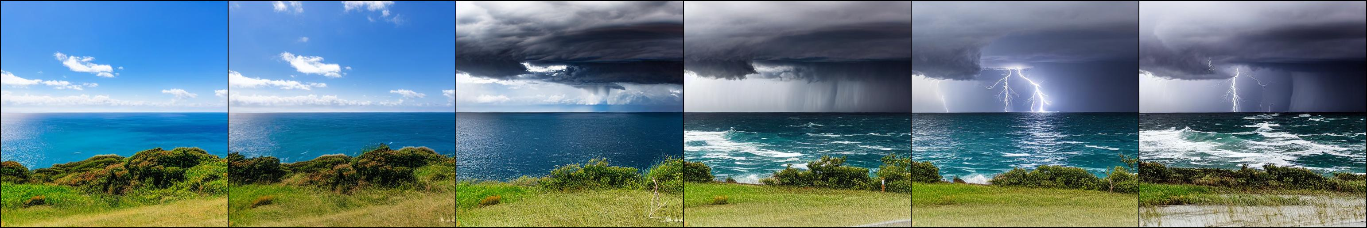
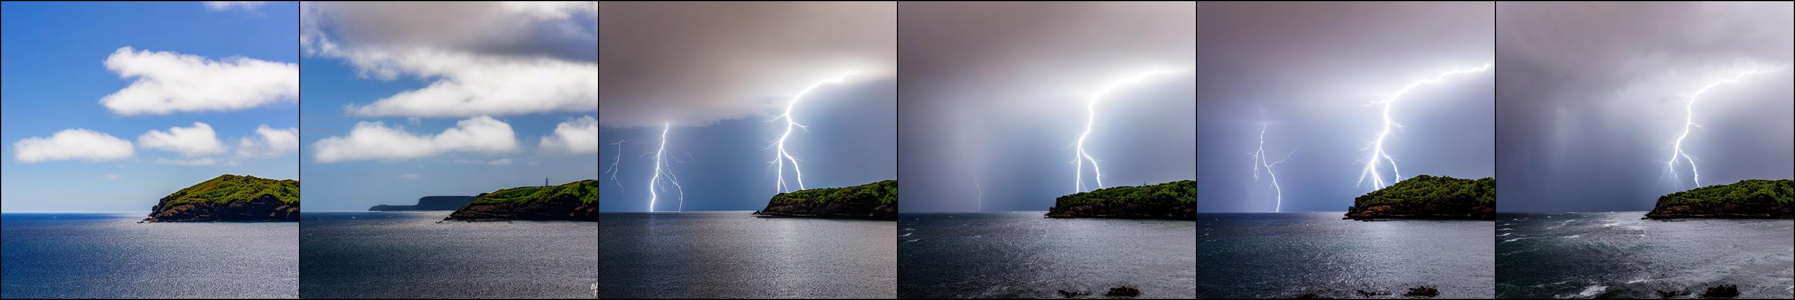
A thunderstorm developing over a sea
Seed=3243241 (paper demo)
Seed=1234
Seed=9999

Slide 6
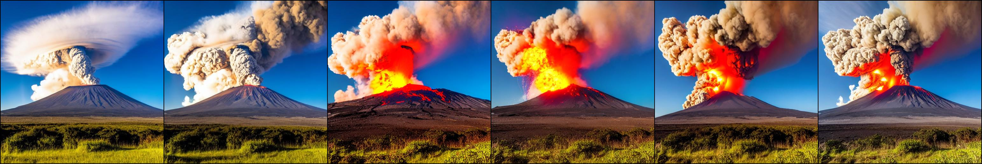
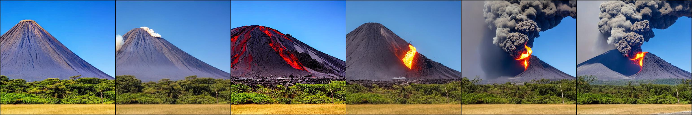
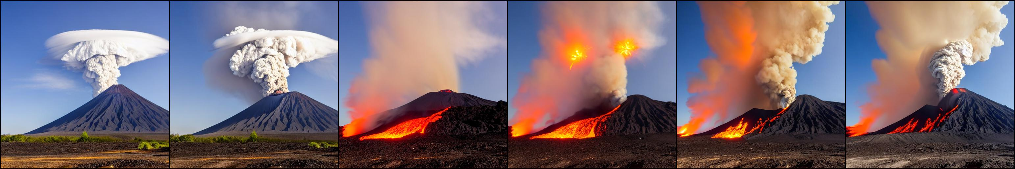
Volcano eruption
Seed=17 (paper demo)
Seed=1234
Seed=9999

Slide 7
123小标题
123内容
3. Free-Bloom: Zero-Shot Text-to-Video Generator with LLM Director and LDM Animator, Shanghai Tech University, NIPS 2023

